Slide 1
Chapter 5: Stacks

Slide 2
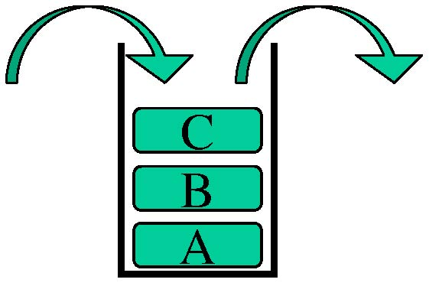
Introduction
A data structure in which all deletions and insertions are allowed only on one end, called the top.
The last entry that is inserted is the first to be removed (LIFO).
A stack is open at one
end (the top) only. You
can push entry onto the
top, or pop the top entry
out of the stack.

Slide 3
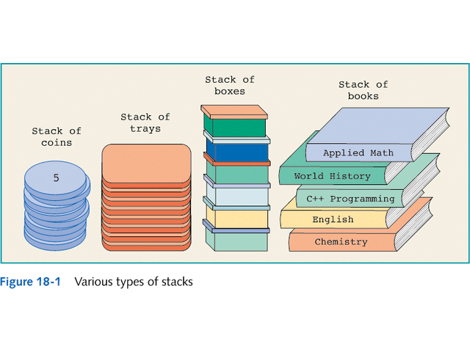
Example

Slide 4

Stack Operations
Two basic operations associated with a stack are:
  Push – The term use to insert an element into stack. Push adds an item at the top of the stack and the new item becomes the top.
  Pop – The term use to delete an element from a stack. Pop removes the item at the top of the stack and the second last item in the stack becomes the top.

Slide 5
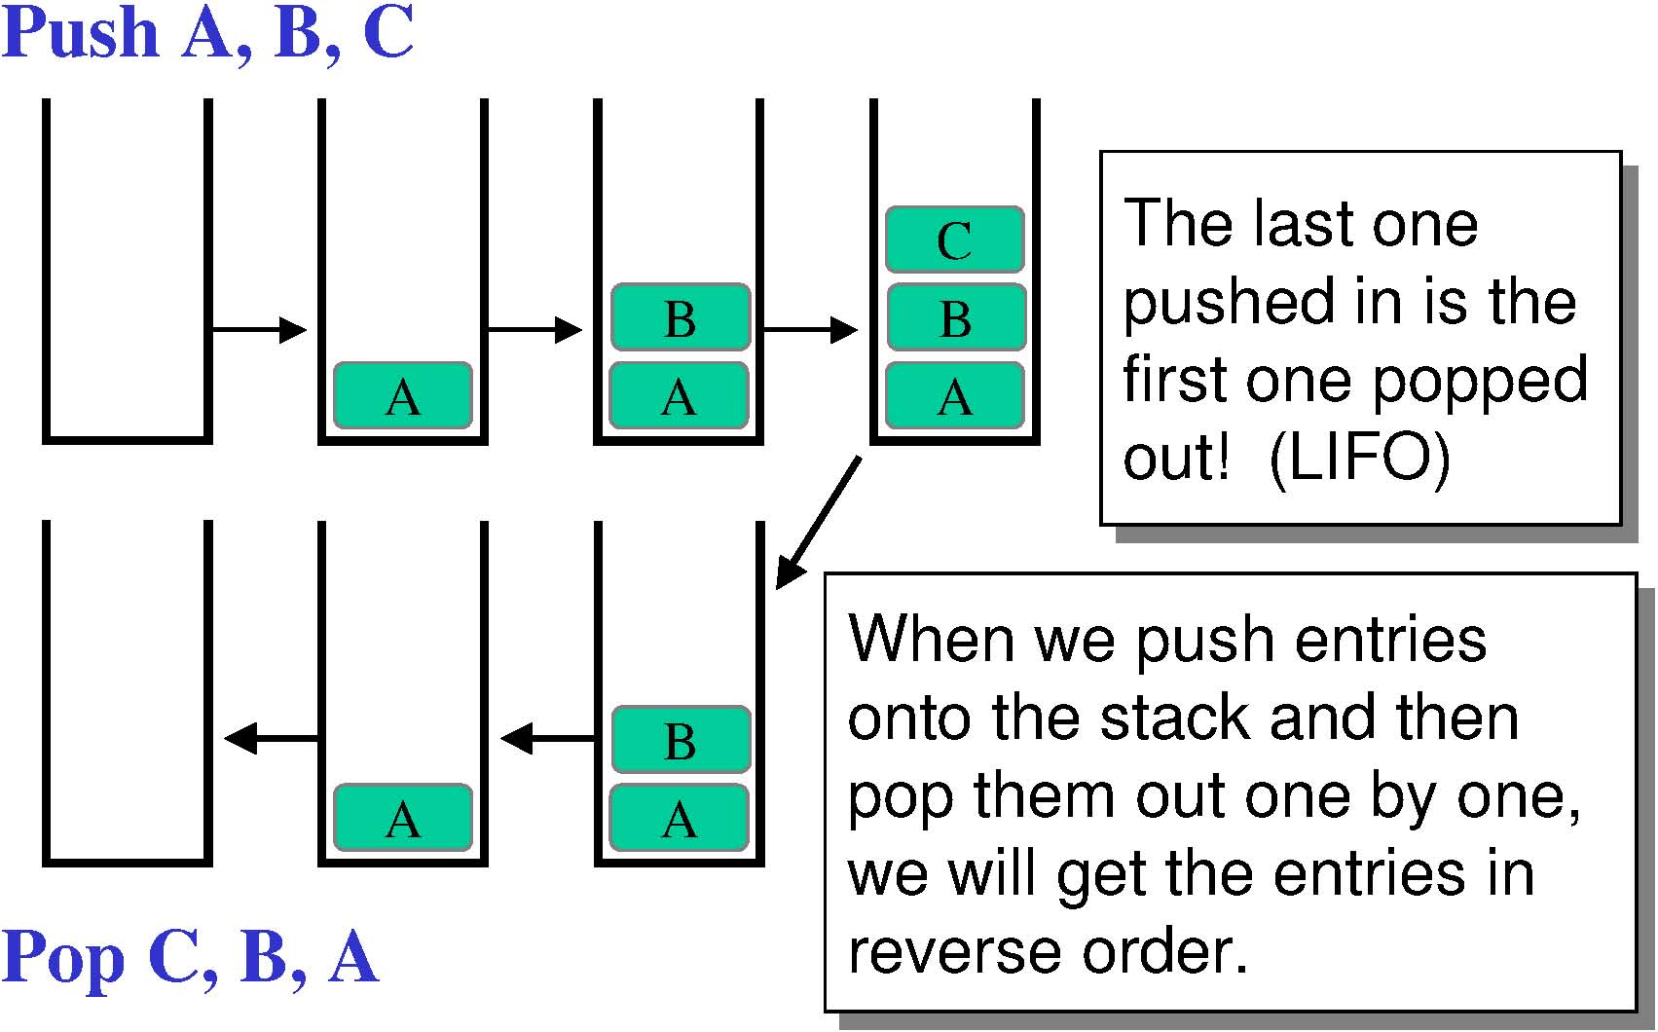

Slide 6
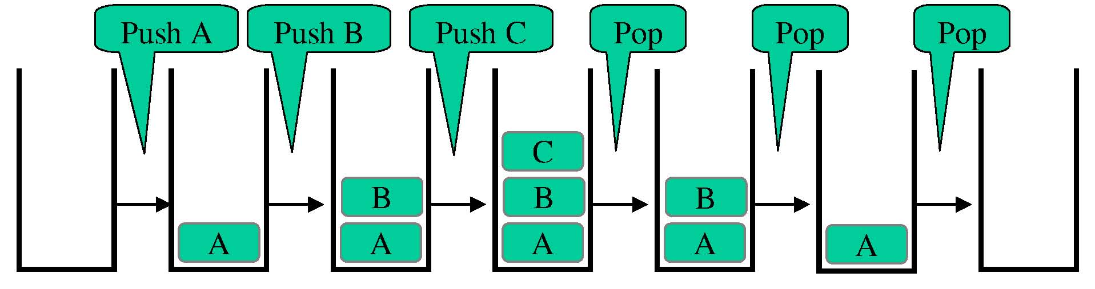

Slide 7
Exercise
Draw a picture after the following operation:
  Push A
  Push B
  Push C
  Pop
  Push D
  Push E
  Pop
  Push F

Slide 8
Array Implementation of Stacks
The first element of the stack is put in the first array position, the second element of the stack in the second array slot and so on.
A variable called top refer to an index of array that point to the top position of stack.
The top of the stack is the index of the last element added to the stack.
A stack element is accessed only through the top, not through the bottom or middle.

Slide 9
Array Implementation of Stacks
Stack[4]
Stack[3]
Stack[2]
45
TOP
Stack[1]
68
Stack[0]
99

Slide 10
Algorithm for Push Operation
1. Check for stack overflow. If overflow occurs, disallow further push operations.
2. If not, increment TOP variable and assign new item to topmost stack element.
3.Exit

Slide 11
Algorithm for Pop Operation
1. Check for stack underflow. If stack underflow occurs, disallow further pop operation.
2. If not, decrement TOP variable by one.
3.Exit.

Slide 12
Exercise
What is the different between underflow and overflow in stack?

Slide 13
Linked List Implementation of Stacks
A linked list is used to implement a stack dynamically.
Its size can grow or shrink during program execution.
Therefore, logically the stack is never full. The stack is full when computer out of memory.

Slide 14
Linked List Implementation of Stacks
In an array representation, top of stacks refer to an index of array.
In a linked representation, insertion and deletion at the beginning of linked list can be used to implement stacks.
Head pointer which contains the address of first node is used to locate the top element in the stack.

Slide 15
Push Operation
Before push
1st node
2nd node
3rd node
…
2
4
6
head
1
newnode
After push
1st node
2nd node
3rd node
…
2
4
6
head
1
newnode

Slide 16
Pop Operation
Before pop
1st node
2nd node
3rd node
…
2
4
6
head
Node to delete
After pop
1st node
2nd node
3rd node
…
2
4
6
head

Slide 17
Exercise
What are the differences between stack implementation using array and the implementation by using linked list?

